Slide 1

Spatially dense air pollutant sampling: Implications of spatial variability on the representativeness of stationary air pollutant monitors
Hugh Li¹, Peishi Gu¹, Qing Ye¹, Naomi Zimmerman¹, Ellis Robinson¹, R. Subramanian¹, Joshua Apte², Allen Robinson¹, Albert A. Presto¹
¹Center for Atmospheric Particle Studies, Carnegie Mellon University, Pittsburgh, PA 15213
²Department of Civil, Architectural and Environmental Engineering, The University of Texas at Austin, Austin TX 78712

Slide 2
Objective
Spatial variation of NO₂, UFP, and PM₁
Modifiable factors to describe pollutants’ spatial variation
Spatial representativeness of monitors in a variety of neighborhoods

Slide 3
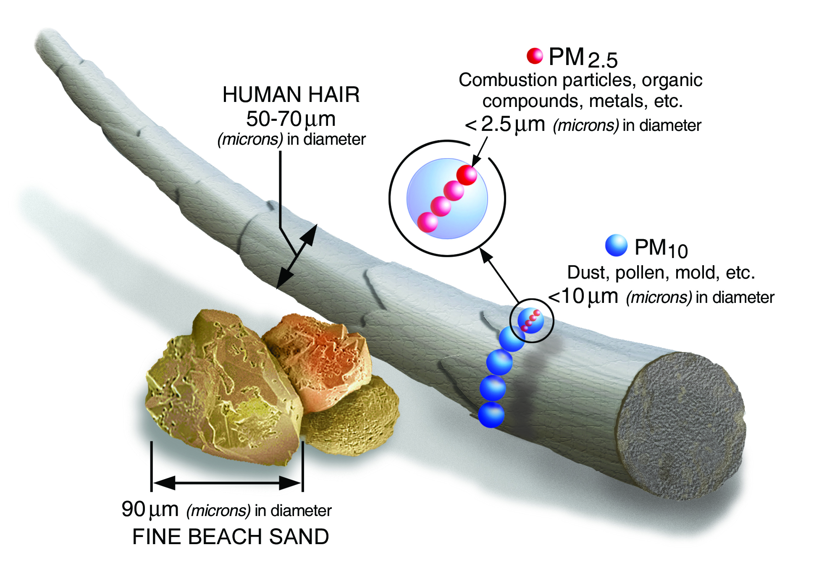
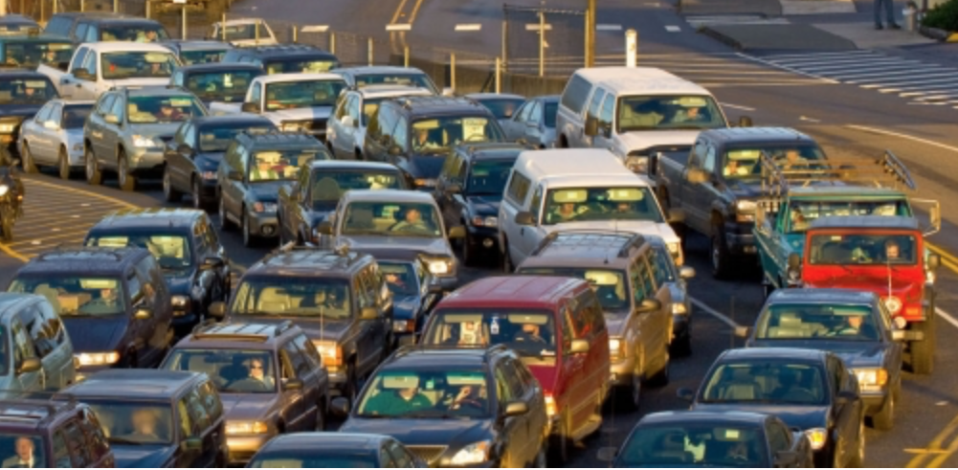
Airborne gas and particle pollutants
Nitrogen dioxide (NO₂)
EPA.gov
Notes:
they are tiny;
EPA set standards for them

Slide 4
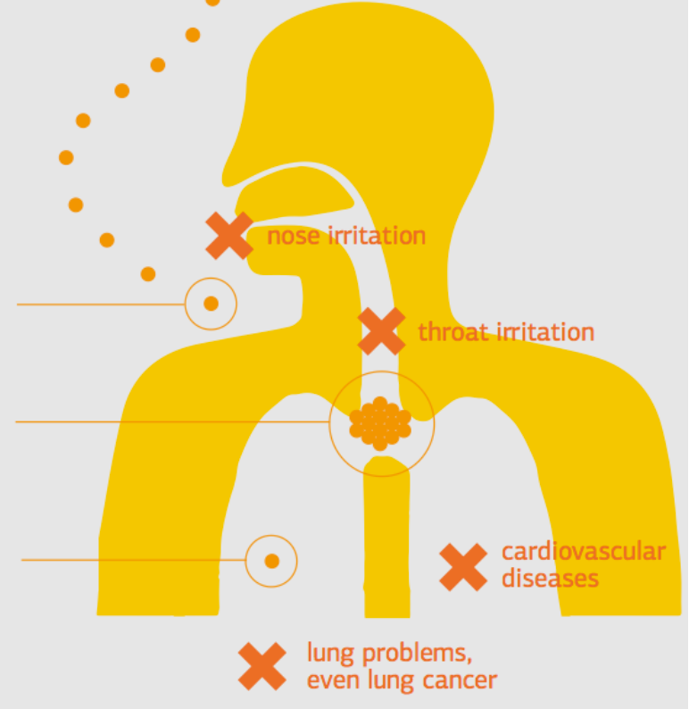
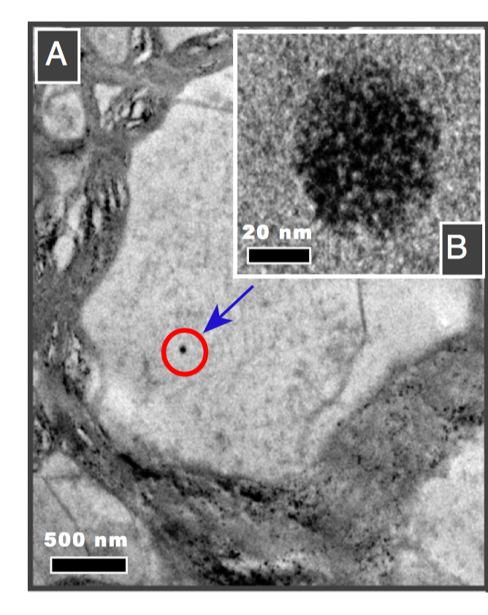
Ultrafine particles (UFP, Da < 0.1 µm) found inside brain
Environment-assured.com
Maher et al., PNAS 2016
Notes:
Ultrafine a new interest, it’s the fraction xxx;
Small size, penetrate through cell membranes, body organs
Transmission electron microscopy

Slide 5
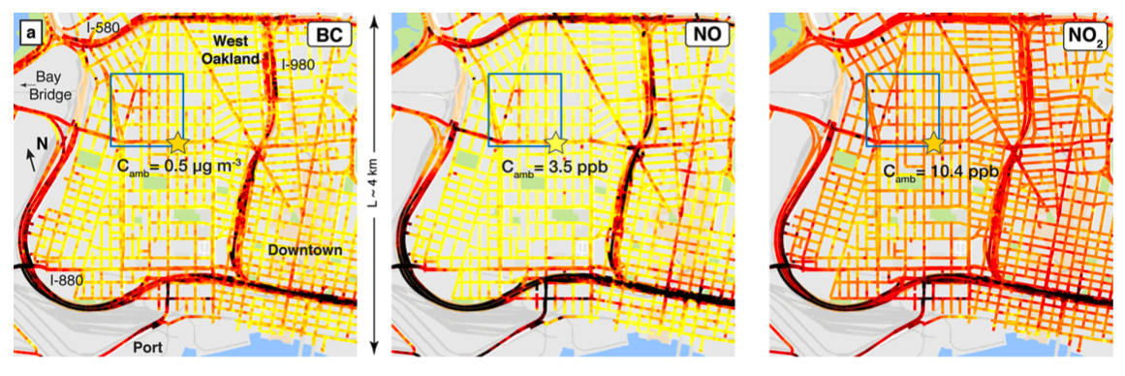
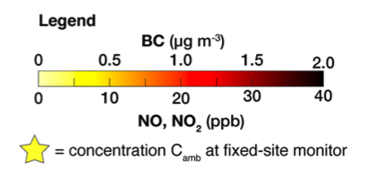
Do regulatory monitors represent air pollution in their surrounding areas well?
4 km
Apte et al., EST 2017
Notes:
They are toxic and here comes another problem, variable;
Here I am showing you the spatial variation of BC, NO, NO2 with mobile sampling using google street view vehicle;
Say here monitors might not represent areas far away

Slide 6
In CTM and remote sensing research, is it fair to assume regulatory monitors can represent a whole modeling grid (~km²)?
Notes:
In other words, can we quantity the uncertainty?

Slide 7
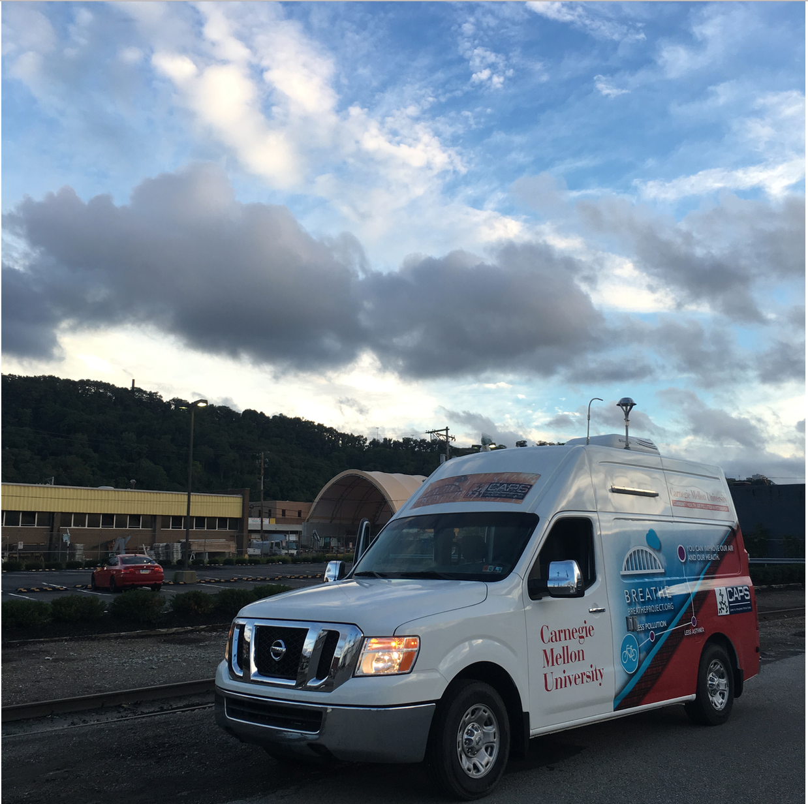
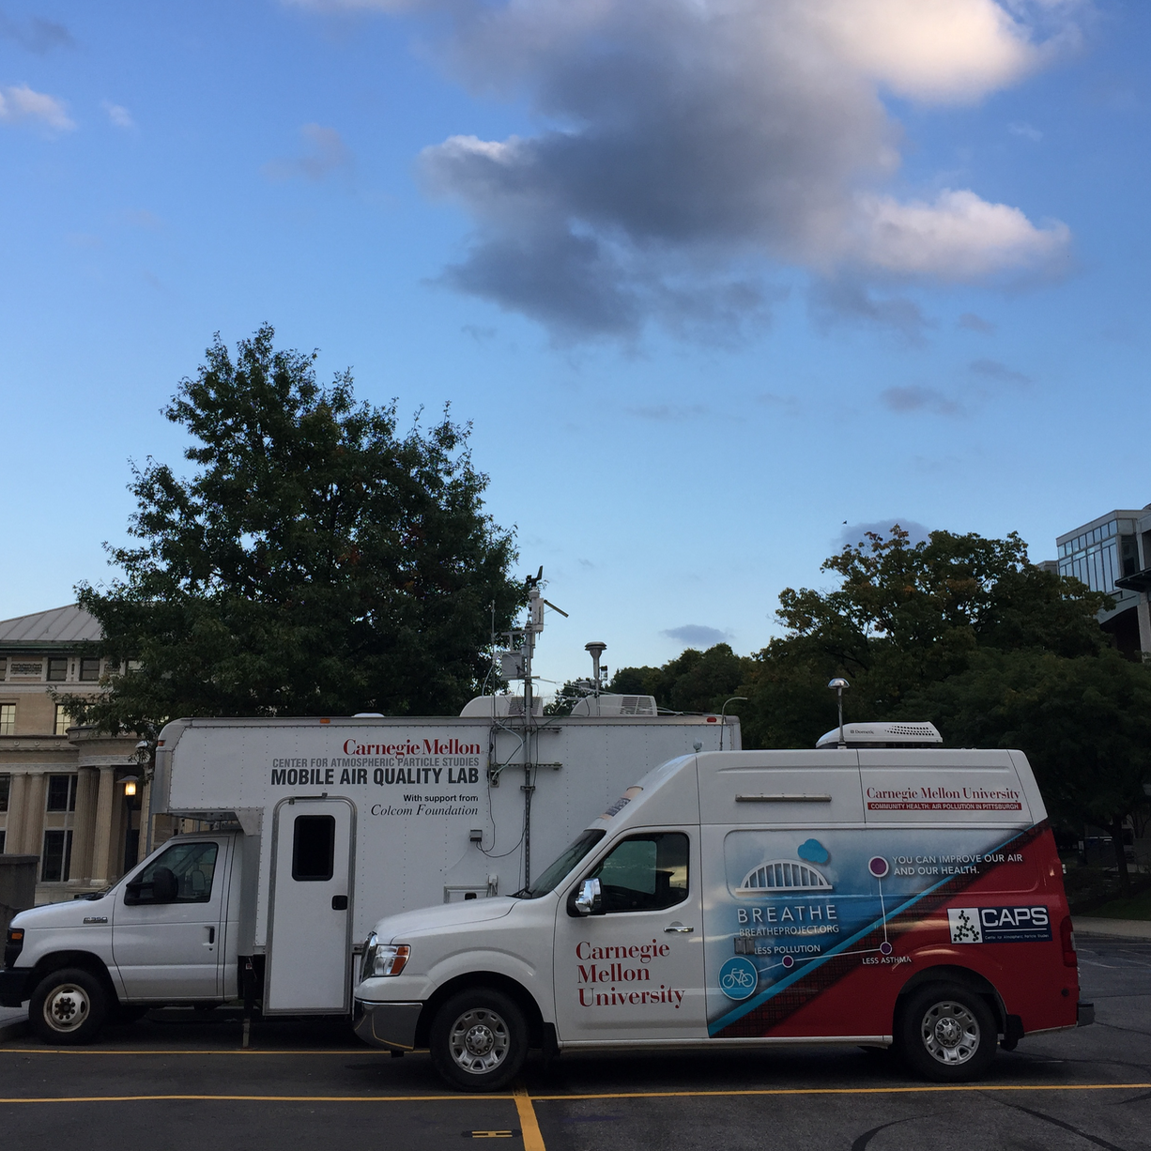
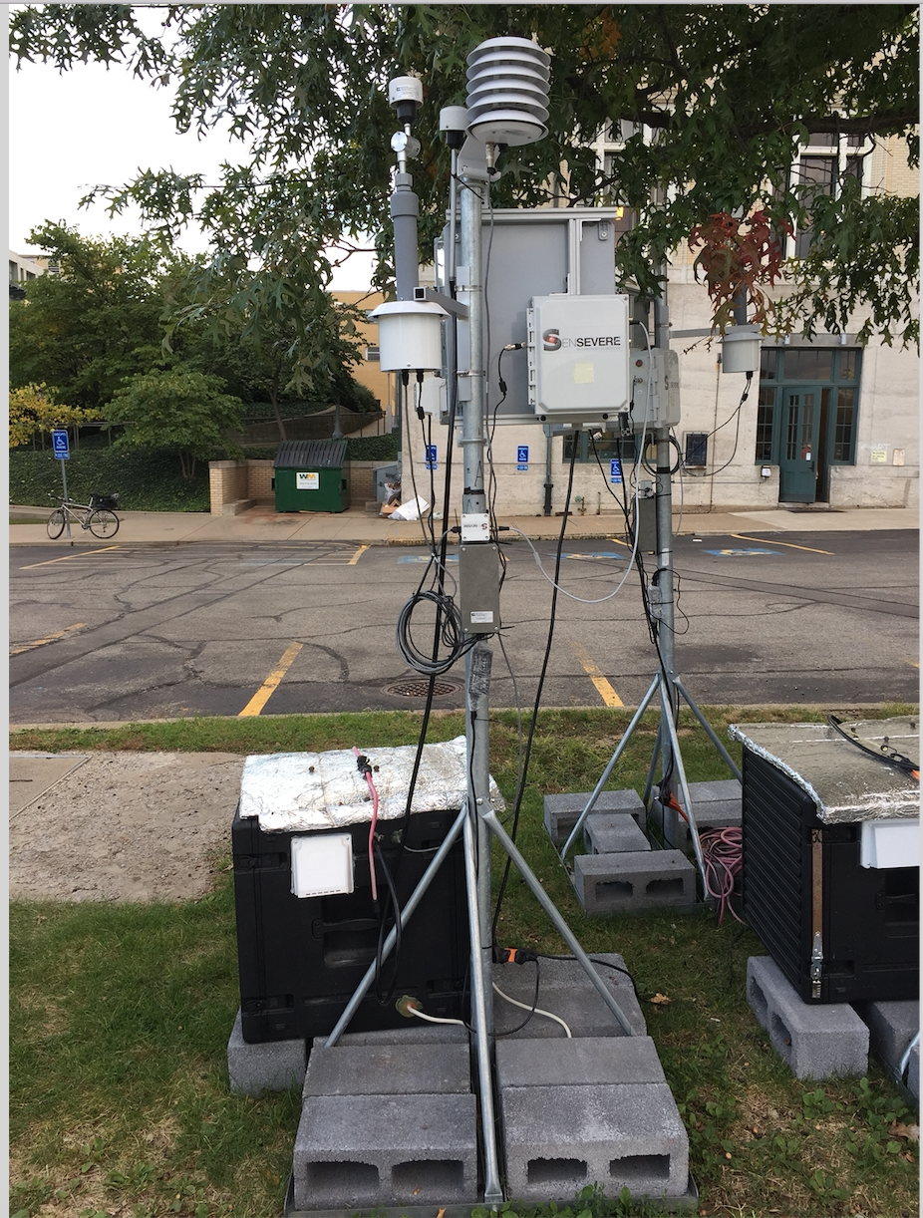
Center for Air, Climate and Energy Solutions
Mobile sampling
Supersite
Stationary monitors

Slide 8
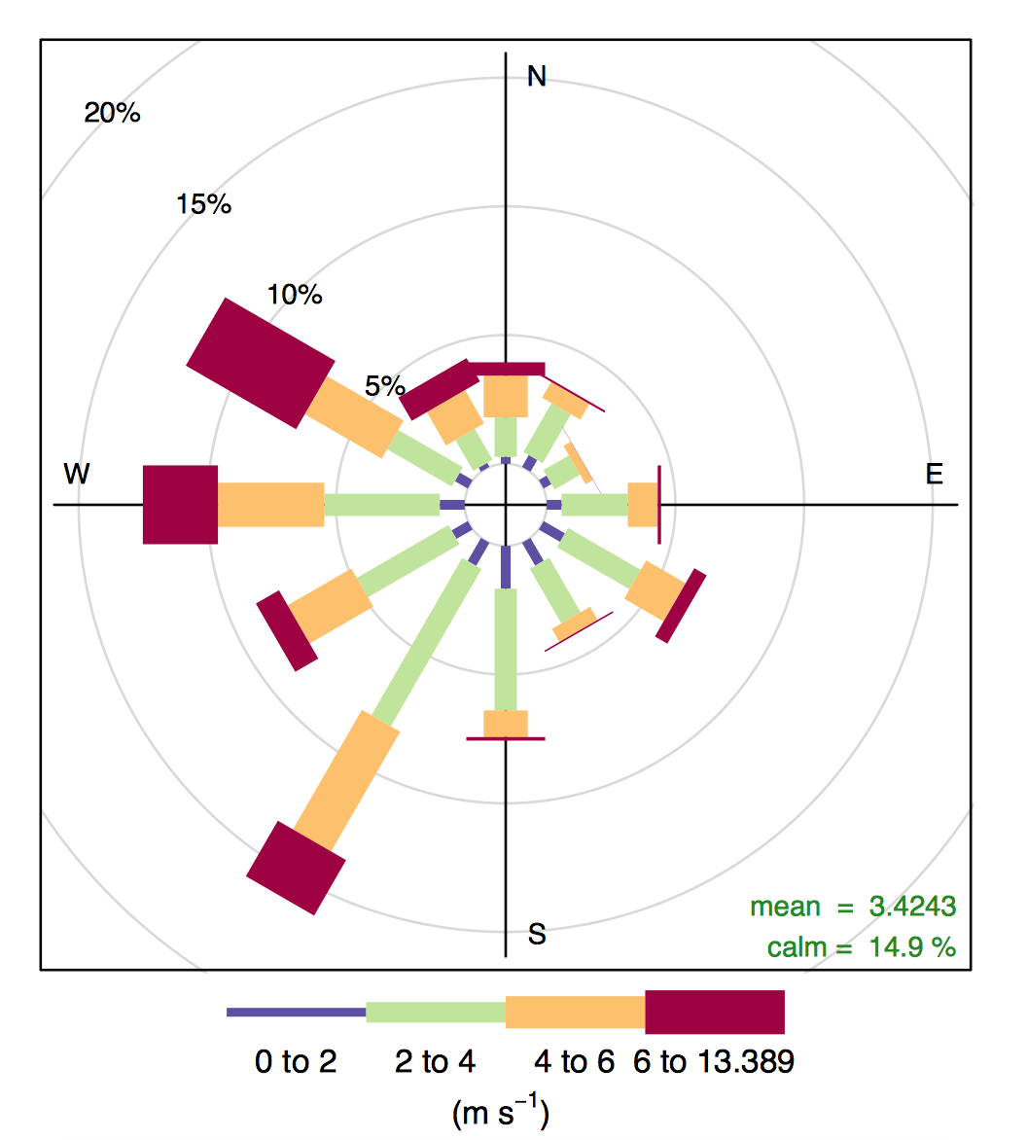
Mobile sampling around stationary monitors
Li et al., Submitted 2018

Slide 9
Instruments on mobile and stationary monitors
Mobile
NO₂ (T200, Teledyne)
UFP (Fast Mobility Particle Sizer 3091, TSI)
PM₁ (Aerosol Mass Spectrometer, Aerodyne)
Stationary Monitor
NO₂ (SenSevere Real-time Affordable Multi-Pollutant monitor)
PN (CPC, Aerosol Devices)
PM_{2.5} (Neighborhood Monitor, Met One)
Notes:
Ramp: Electrochemical sensors
PM1 from AMS also includes BC

Slide 10
Both mobile and stationary sampling describe similar pollutant gradient

Slide 11
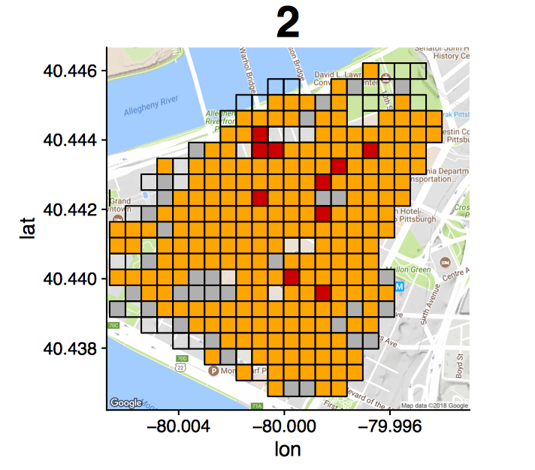
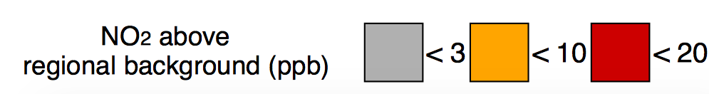
Downtown area 2 shows hyperlocal (~50 m) spatial variation
Notes:
NO2 regional background 7 ppb
Median enhancement, so less outlier effect

Slide 12
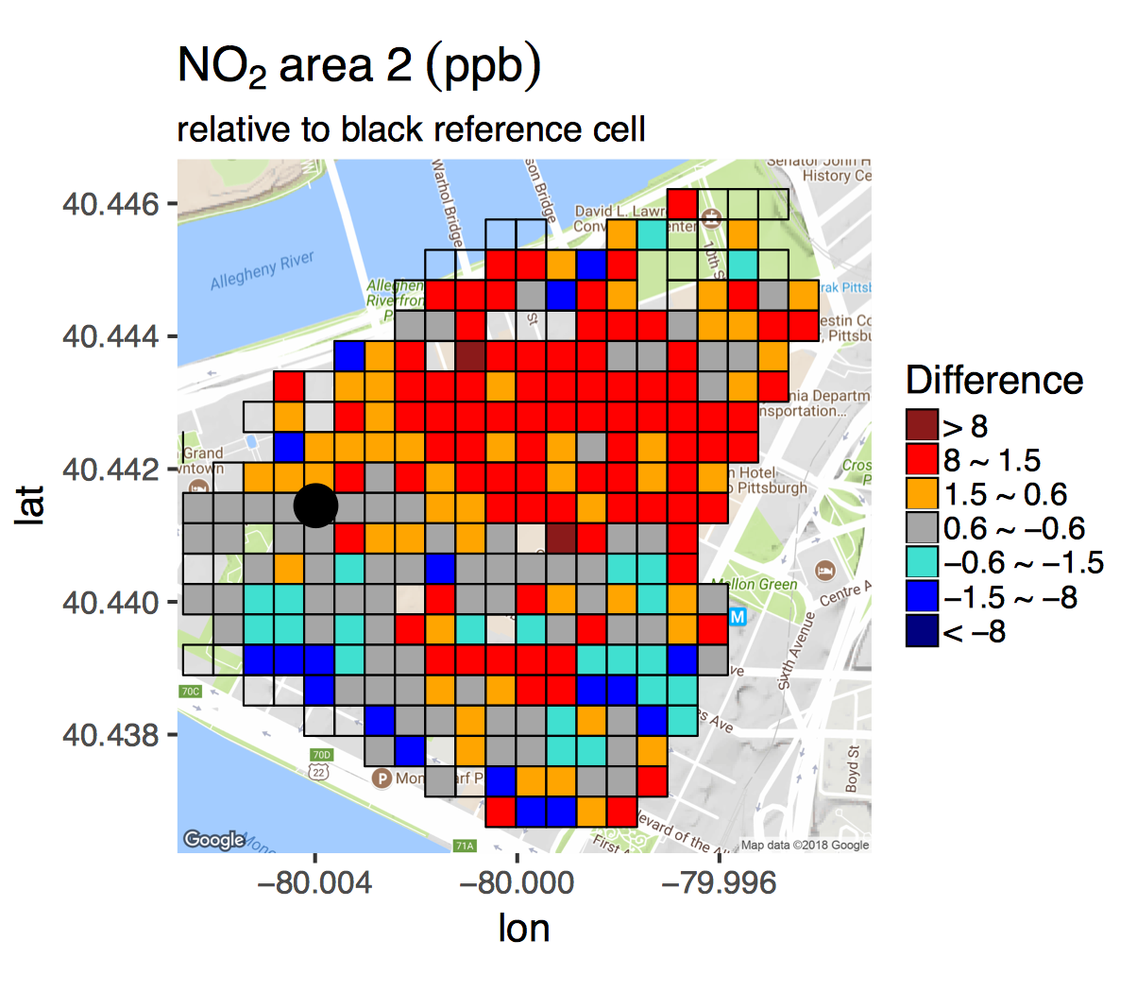
In urban areas, using one monitor to represent surrounding neighborhoods introduces errors for NO₂
12

Slide 13
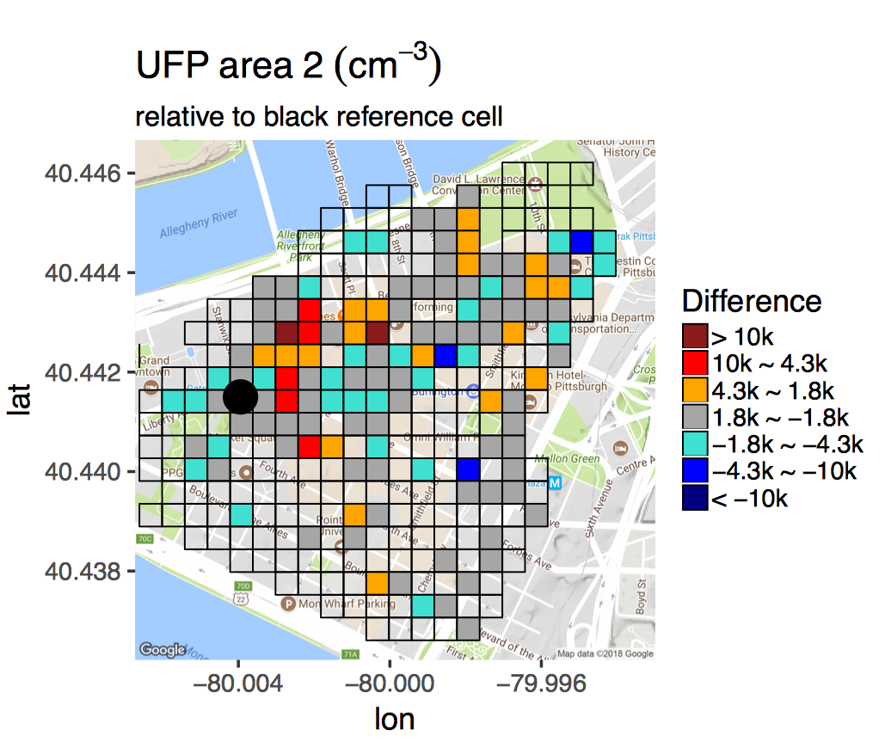
UFP is highly variable both spatially and temporally
Notes:
Grey boxes 1800/6200 = 30% of regional background

Slide 14
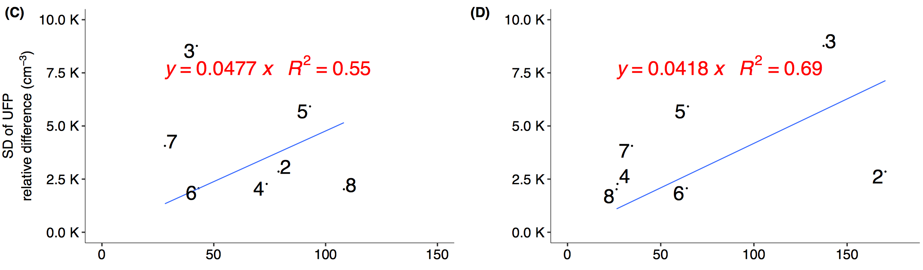
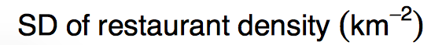
UFP spatial variation correlates with traffic and restaurant density
Notes:
Site 1 missing due to instrument vibration issue
This one describes the CTM issue

Slide 15
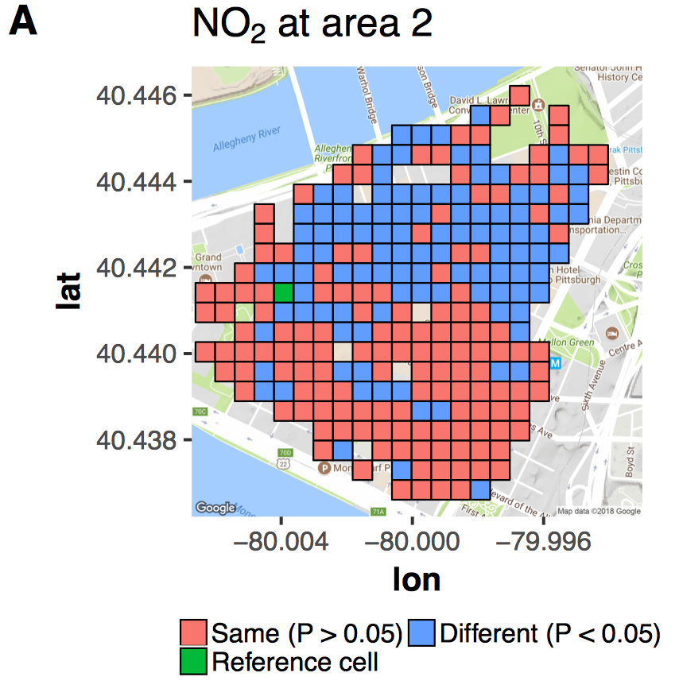
The reference cell statistically represents 60% of the 1 km² driving domain
Notes:
Nonparametric Wilcoxon rank-sum test

Slide 16
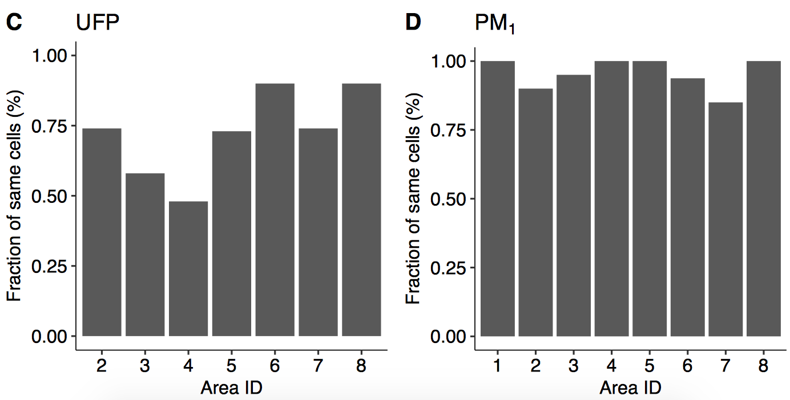
Urban monitors less spatially representative than suburb ones for UFP
Notes:
Y statistical not significant (similar) cells
But for PM, they both ok

Slide 17
Conclusion
NO₂ shows within-neighborhood (~1 km²) spatial variation, hotspots elevated ~5X regional background.
Spatial differences between stationary monitors and nearby UFP can be 2.5X regional background.
Spatial variability of NO₂ and UFP has moderate correlation (R² > 0.5) with modifiable factors like restaurant and traffic.
Urban monitors represent less spatial extent of their surroundings compared to suburbs ones for NO₂ and UFP.

Slide 18

Thanks for your attention!
Prof. Albert A. Presto
Center for Atmospheric Particle Studies (CAPS)
Carnegie Mellon University, PA
apresto@andrew.cmu.edu
RD83587301
Photo courtesy of Xiang Li

Slide 19
NO₂ at urban areas more variable than suburbs
Notes:
Change color (urban) vs. suburbs

Slide 20
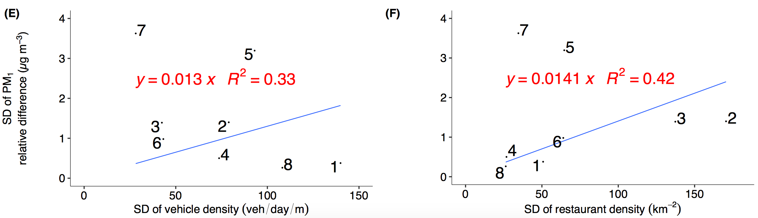
Secondary PM₁ worse correlation with traffic and restaurant

Slide 21
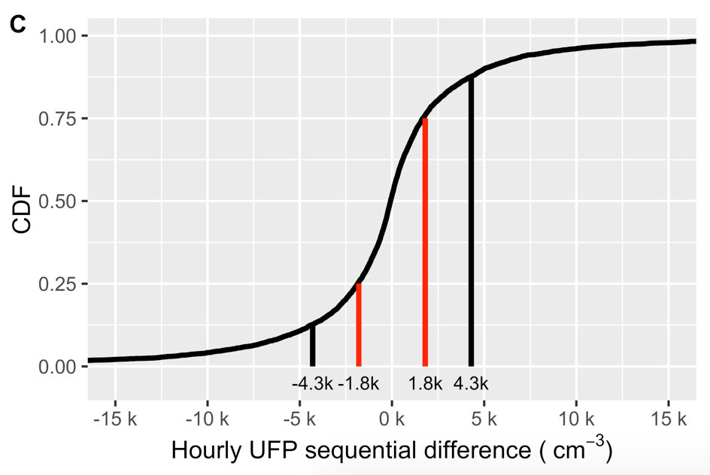
CDF of hour-to-hour UFP variation based on stationary monitors
Red: 50% range
Black: 75% range

